Slide 1
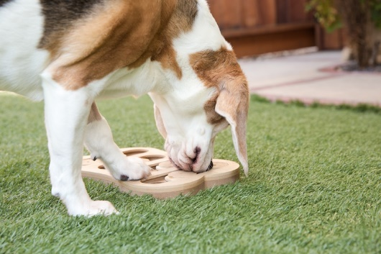
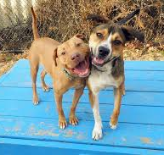
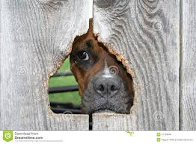
Nuisance Behaviour – A Barking Dog
Why might my dog be barking ?
Attention seeking or communication
Provoked intentionally/unintentionally by humans, wildlife or other pets
Lack of space or exercise
Sickness or poor diet
Separation anxiety
Hungry or thirsty
Being neglected
Territorial
Playfulness
Boredom
EXERCISE
A tired dog is a happy dog
Exercise help reduce boredom and anxiety-based behaviours in your dog such as barking and chewing, so you will be amazed by the changes you see in your dog when you implement a regular exercise routine.
ACTIVITY TOYS
Treat balls can be filled with dry food or treats and given to your dog who then has to get the food out by pushing the ball along the floor with his nose. This is a great way of feeding your dog’s meal to him as it takes longer to eat and tires him out in the process
What are some solutions to assist with excessive barking ?
You can avoid having a barking dog by making sure you provide the correct care for your pets and satisfy their needs. Nuisance barking is
common when families are away from home. Your dog doesn't want to stay behind and if it has no entertainment it may easily become bored, lonely or frustrated often leading to nuisance barking. Another dog or pet may help or even just leave a radio on while you’re not at home. You do need to ensure that loneliness is the issue as dogs mimic each others behaviours and you don't want two nuisance dogs.
There are many different kinds of puzzles that have been created for dogs with varying degrees of difficulty. Most puzzles have places where you can hide food and your dog has to then work out how to get it out of the puzzle.
Remove direct line of sight
If you have discovered your dog is barking at people, other dogs or things in the neighbourhood try and cover any open fencing or gaps in the fence. Alternatively, prevent access to the area if possible.
Separation Anxiety…
Separation anxiety can be a hard behaviour to modify and time is needed for success. If your dog suffers from separation anxiety, you will need to enlist the help of a qualified positive reinforcement trainer to help you with a plan.

Slide 2
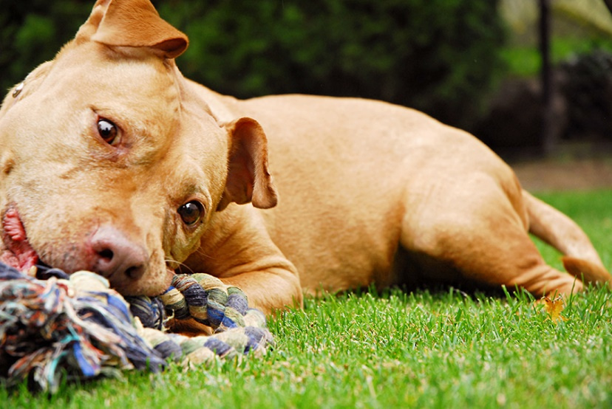
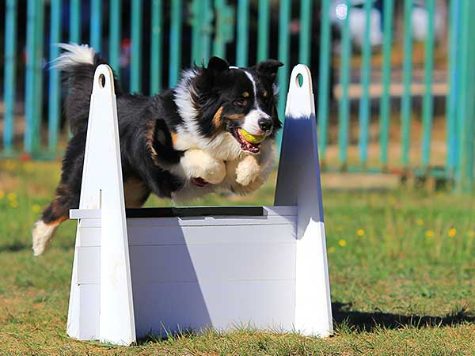
What happens if I don’t stop my dog from barking ?
If you chose not to do anything to prevent your dog from barking and Council receives another complaint, Council Rangers will conduct an investigation to determine if your dog is or is not a nuisance. If the Rangers investigation determines that your dog is being a nuisance it is most likely that a Nuisance Order will be placed on the dog. A Nuisance Order stays in place for 6 months and it is during this time that you must prevent the dog from creating a nuisance. If the behaviour of the dog does not change in this period Council Rangers may issue a penalty infringement from $275.00 for failing to comply with a Nuisance Order.
As part of the investigation Rangers will check the identification (microchip) and registration of any animal that comes to their attention. If your dog is not identified and registered a notice will be issued asking you to do so. Failure to comply may result in a $485.00 fine.
Exercise and Enrichment
Each dog needs an outlet that is specifically designed to motivate them and serve their particular needs.
Find an activity or sport that your dog really enjoys doing, taking into account what your dog’s breed or mix of breeds is.
Enrich your dog’s life inside the home by hiding toys or food around the house and encouraging them to seek them out using their canine senses to find them.
Instead of feeding your dog from a bowl for every meal, try feeding them through activity toys at meal times instead so that they have to work to find and eat their food.
Working for meals will stimulate your dog’s brain and help tire them out !
What if it’s not my dog barking ?
On occasion people have mistaken where the nuisance barking is actually coming from. If this is the case and you believe it is another dog in your neighbourhood please contact the Rangers on the number provided and give them any further information you have on where the barking is coming from.
The Ranger will then also contact the complainant and check to see if there has been a mistake made.
Section 32A(b) of the Companion Animals Act 1998 states that a dog may be declared a nuisance if the dog:
‘makes a noise, by barking or otherwise, that persistently occurs or continues to such a degree or extent that it unreasonably interferes with the peace, comfort or convenience of any person in any other premises’
Thank you for taking the time to read this information. Your co-operation is appreciated. If you have any further enquires please call the Goulburn Mulwaree Council Rangers on (02) 4823 4409.

